Slide 1
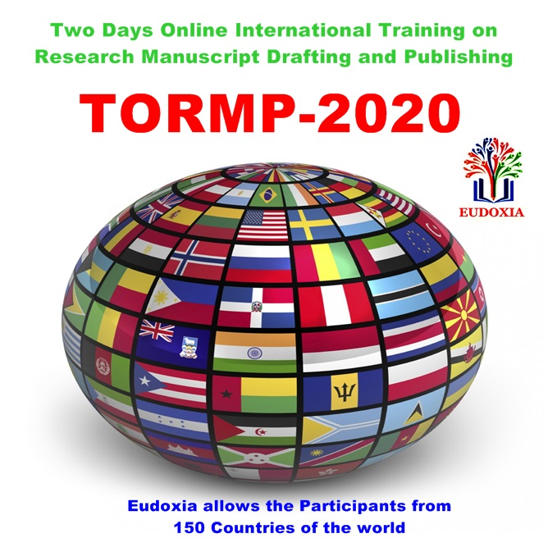
Two days online International training on research manuscript drafting and publishing
Day-2: 17th May-2020
Topic:
Free publication of thesis and dissertation in foreign countries with ISBN number
Resource Person:
Hemlal Bhattarai, Dean Research & Industrial Linkages, Jigme Namgyel Engineering College, Royal University of Bhutan

Slide 2
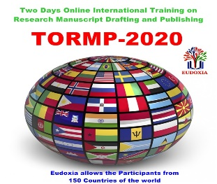
Outlines
Two days online International training on research manuscript drafting and publishing
Personal:- Highlight and Background.
Competent Business;
Publication:- General, publication platform, free publication of thesis & dissertation, publication in foreign country, publication with ISBN.
Publication:- Critical knowhow and awareness.

Slide 3
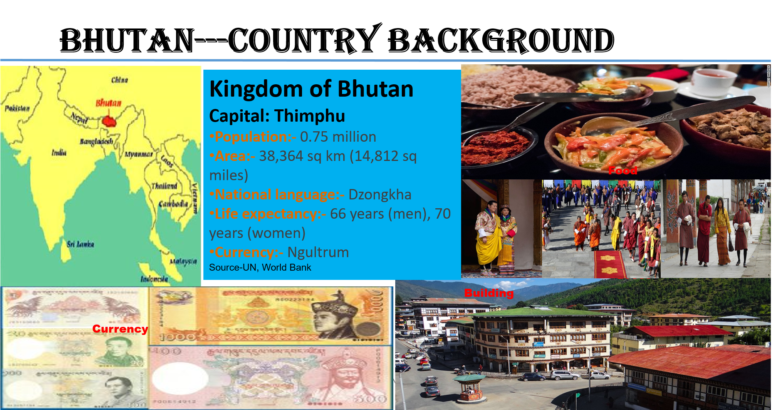
background
Two days online International training on research manuscript drafting and publishing

Slide 4
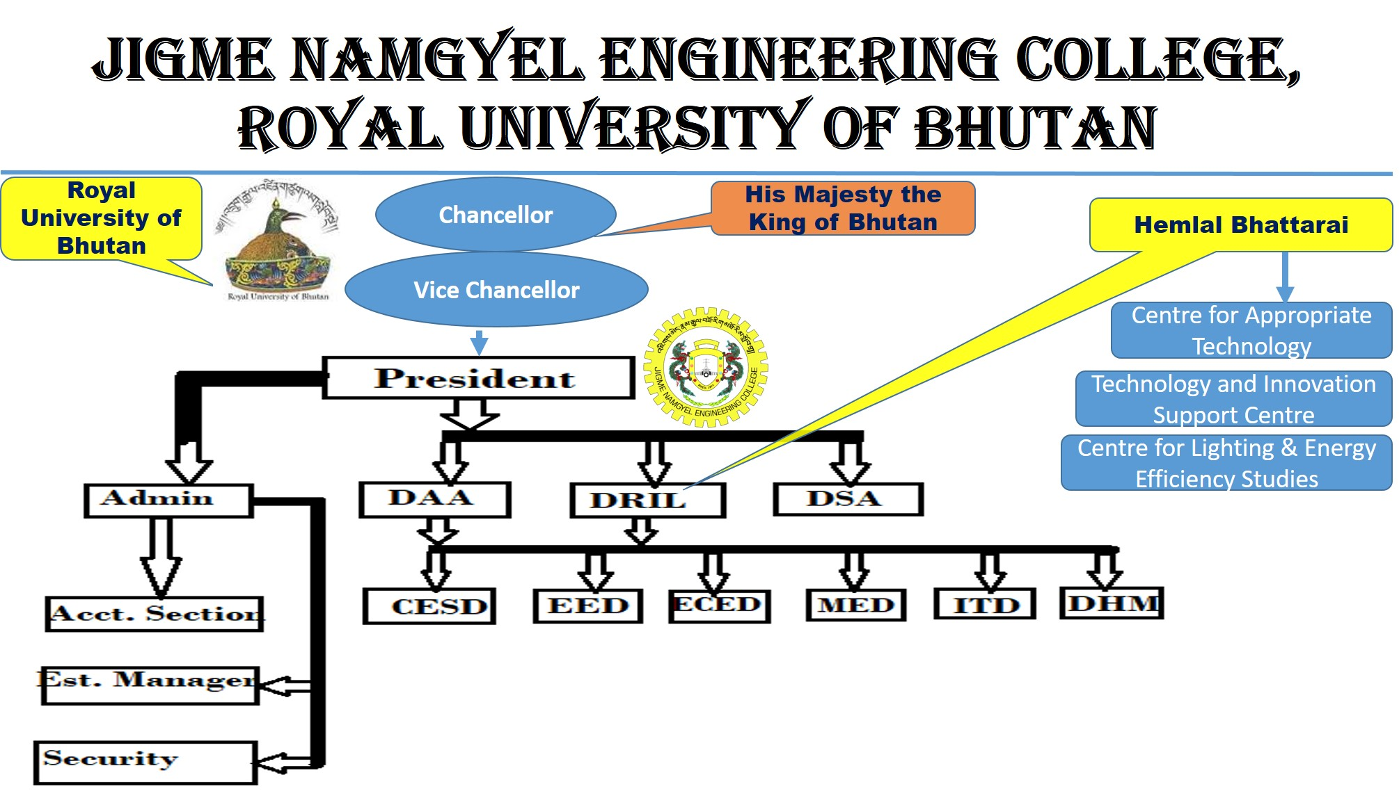
background
Two days online International training on research manuscript drafting and publishing

Slide 5
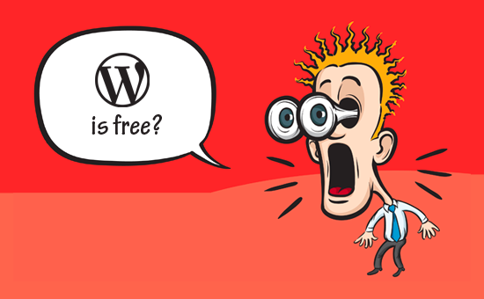
Ice-breaking
Two days online International training on research manuscript drafting and publishing

Slide 6
CB:- Publication
Two days online International training on research manuscript drafting and publishing
Publication:- General
??? As book
WHAT?
Thesis
& Dissertation
WHY?
Free
&
Foreign Countries
WHERE?
HOW?
ISBN
Notes:
-The International Standard Book Number (ISBN) is 13 digits long if assigned on or after 1 January 2007, and 10 digits long if assigned before 2007

Slide 7

It really matters
Two days online International training on research manuscript drafting and publishing

Slide 8
CB:- Publication
Two days online International training on research manuscript drafting and publishing
Publication:- General
Thesis & Dissertation
Basically an exercise
Work to prove something through findings
It might be a case/part (to show how much you know).
WHAT?

Slide 9
CB:- Publication
Two days online International training on research manuscript drafting and publishing
Publication:- General
Book
Basically done as interest & passion, contribution, reputation,…
Mater of hard works and genuine efforts.
Professionally-Sharing.
WHY?

Slide 10
CB:- Publication
Two days online International training on research manuscript drafting and publishing
Publication:- General
Free & Foreign Countries
Free---As already paid, economical situations, intention.
Foreign Countries--- Wider audiences and avenue, reputation...
WHERE?

Slide 11
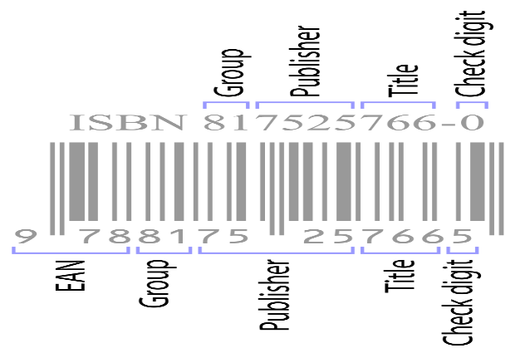

CB:- Publication
Two days online International training on research manuscript drafting and publishing
Publication:- General
Book with ISBN
HOW?
Book---Want to say something, Specific and larger audiences, join and create conversation...
ISBN--- authenticate, genuine, intellectual property .
Notes:
Dissertation---It is an exercise…something to prove---purpose might be in part (to show how much you know).
Book--- something to say, purpose is argument and join and create conversation, ----put yourself in reader place---people centric (audience/subject etc)

Slide 12
CB:- Publication
Two days online International training on research manuscript drafting and publishing
Publication:- General
Publishing a Book with ISBN
3 W’s
Why?
Why write this book?
Objectives and
What?
What should the book about?
Clear content or thematic selection.
Who?
Who is going to read?
Target audience to be identified.
Goals.
Source: Popularize your research, By Aïna Olagnon

Slide 13
CB:- Publication
Two days online International training on research manuscript drafting and publishing
Publication:- General
Platform for Free Publication
Factors of consideration;
In full
or
in part
As a book or
chapter
Broader intentions.
or
or

Slide 14
CB:- Publication
Two days online International training on research manuscript drafting and publishing
Publication:- General
Platform for Free Publication
Scoping exercise is vital here.
Critical analysis.
Authenticate the right platform based on the objectives & records.

Slide 15

background
Two days online International training on research manuscript drafting and publishing

Slide 16
CB:- Publication
Two days online International training on research manuscript drafting and publishing
Publication:- Some platforms (example)
universalpublisher
abuzz
grin
scholars-press
bookriz
Platform for Free Publication (example)
pothi
lambert
kdp.amazon
tckpublishing

Slide 17
CB:- Publication
Two days online International training on research manuscript drafting and publishing
Platform for publication (eg.)
www.scholars-press.com, -------Riga, Latvia
Free of charge,
Remunerate the Author with royalties,
Royalty every after 12 month,
If the Author wishes to make any changes to his / her Work AFTER THE PUBLICATION, then the Publisher has the right to demand a fee of 150 EUR for post-publication services.
12% & 30%
Notes:
-Remunerate the Author with royalties in the amount of 12% of the Work's net sales and in the amount of 30% of the licensing income generated from the use of Work by third parties when – during the accounting period of 12 months – they generate claims of more than 50,- EUR on average per month.

Slide 18
CB:- Publication
Two days online International training on research manuscript drafting and publishing
Platform for publication (eg.)
2. www.lap-publishing.com, Riga, Latvia
Free of charge,
Remunerate the Author with royalties,
Royalty every after 12 month,
If the Author wishes to make any changes to his / her Work AFTER THE PUBLICATION, then the Publisher has the right to demand a fee of 150 EUR for post-publication services.
Omniscriptum Publishing
12% & 30%

Slide 19
CB:- Publication
Two days online International training on research manuscript drafting and publishing
Platform for publication (eg.)
3. https://www.grin.com -Munich Germany
Free publication
Royalties to the author.
Worldwide distribution.
Be clear of publishing it as ebook or printed book…author choice.
Upto 45% & 20%
Notes:
Over 200000 academic texts, 83000 satisfied authors.
Publish for free & earn money with your theses, term papers, presentations and essays.
Publish your dissertation for free. Free publication. Publish your doctoral thesis – completely free of charge and with ISBN
-Royalties to author. With GRIN you get up to 45 % for each sale of your doctoral thesis as eBook and up to 20 % for the publication as book. Worldwide distribution.

Slide 20
CB:- Publication
Two days online International training on research manuscript drafting and publishing
Platform for publication (eg.)
4. https://kdp.amazon.com/ -USA
Free publication,
Royalties to author,
Widespread reach and self-publishing,
Has KDP select exclusivity---(Free book giveaway, kindle countdown deal) , 90 days exclusive for KDP-good beginning for beginner,
-Start with KDP with 1st, more books continue and go wider.
35% & 70%
Notes:
They also offer competitive royalty rates of 35% for books prices under $2.99, or 70%, for all books priced between $2.99 and $9.99.

Slide 21
CB:- Publication
Two days online International training on research manuscript drafting and publishing
Platform for publication (eg.)
5. https://www.tckpublishing.com/publishing-faq/ ----USA
Free of charge.
Pay royalty to authors.
The editors from publisher provide free developmental editing, copy editing, line editing, and proof reading services to authors.
Book will be available all over the world in the U.S., U.K., Canada, France, Australia, Germany, Japan, and many other countries through Amazon and other distribution channels.
50%
Notes:
-Pay royalty to authors 50% (for all format) of net royalties and 50% of all payments received for subsidiary rights licensing deals. If we earn $10,000 in royalties, you get paid 50% of that amount, or $5,000.
If we earn $5,000 for a 5-year deal to license German language rights for your book, you earn 50%, or $2,500.

Slide 22
CB:- Publication
Two days online International training on research manuscript drafting and publishing
Platform for publication (eg.)
6. http://dissertation.com/agreement.php ----USA
Post your abstract for free.
Ebook publication is $99.
Paperback setup is $299.
Pay royalty to author.
The publication will be automatically made available in additional ebook formats such as ePub (for iPhone, iPad, iTunes), Amazon Kindle, and many Android eReaders such as Nook.)
10% to 20%
Notes:
-Universal publisher
-10% to 20% author royalty on sales according to the Publishing Agreement. (Annually)
ISBN Provided

Slide 23
CB:- Publication
Two days online International training on research manuscript drafting and publishing
Platform for publication (eg.)
7. https://pothi.com/ ---India
Free publication
For ebook-MRP of the eBook is set by you. It can be zero or a minimum of Rs. 50. Similarly for Print Publishing---calculated.
Royalty provided to author.
Sold through its own stores or through other channels.
75% & 25%
Notes:
-No ISBN (ISBN can be freely achieved in many countries including India)
-Author Margin/Royalty is 75% of the MRP when sold through Pothi.com's store and 25% of the MRP when sold through other channels.

Slide 24
CB:- Publication
Two days online International training on research manuscript drafting and publishing
Platform for publication (eg.)
8. https://www.abuzzpress.com/ ---USA
Free publication
Royalty provided to author.
Publishing and Distribution.
Retain 3 year exclusive printing right.
70% & 60%
Notes:
-ISBN
-60% print, 70% ebook
-currently for U.S citizen only.

Slide 25
CB:- Publication
Two days online International training on research manuscript drafting and publishing
Platform for publication (eg.)
9. https://www.bookrix.com/
Free publication
Royalty provided to author.
Publishing and Distribution.
Have full flexibility.
Just 30 days notice necessary.
70%
Notes:
-ISBN
-70% of sales.

Slide 26
CB:- Publication
Two days online International training on research manuscript drafting and publishing
Platform for publication (eg.)
Paid one----
https://www.statperson.com ----India
Publication with some fees.
Rs. 10000 (Ten Thousand Rupees Only)/ approx. USD-135 for SIX copies of Books include ISBN
Royalty provided to authors.
Max. 30%
Notes:
-someone need your Book for Reference purpose, we definitely sell it and give Royalty to corresponding Authors.
-If, in future, We sell your Book, Maximum 30% royalty will credited to your Account.
-ISBN provided

Slide 27

CB:- Publication
Two days online International training on research manuscript drafting and publishing
Publication:- Knowhow
Vanity
Reputable
Publisher
Predatory
Notes:
-even:- Self-publishing
-https://www.tudelft.nl/en/library/current-topics/libraryfor-researchers/library-for-researchers/publishing-outreach/creating-your-publishing-strategy/about-questionable-publishers/
Highlight it as vanity publisher (esp. Omniscriptum, that operates under a number of names or imprints, including Scholars’ Press and LAP Lambert. )

Slide 28
CB:- Publication
Two days online International training on research manuscript drafting and publishing
Publication:- Knowhow-Self-publish
Write Book
Self-edit the manuscript.
Have your book professionally edited (and formatted, if needed).
Have your book cover professionally designed.
Choose a self publishing platform to publish and/or distribute the book.
Market your book.
Maintain your book.

Slide 29
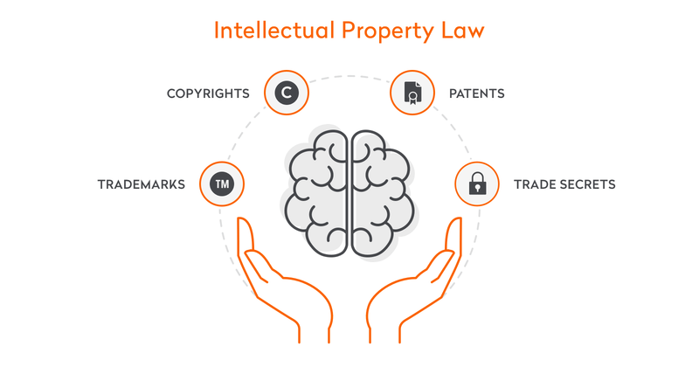
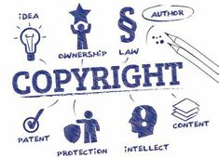
CB:- Publication
Two days online International training on research manuscript drafting and publishing
Publication:- Knowhow
Notes:
-Books often contain more than one copyright: in the literary content (the text) and also in different artistic works if it contains drawings, paintings or photographs. Each one of these copyright works is the subject of a contractual agreement permitting its reproduction and publication, and, where the publisher does not himself acquire the rights contractually, he acquires a license to exploit them.
-What is copyright?
Copyright is a legal concept describing rights given to creators for their literary and
artistic works which include books, music, works of fine art such as paintings and
sculpture, as well as technology-based works such as computer programs and
electronic databases. A work does not need to be published or ‘made available
to the public’ to be protected. It is protected from its creation.

Slide 30
CB:- Publication
Two days online International training on research manuscript drafting and publishing
Publication:- Knowhow
At a minimum, you should carefully consider whether your publisher needs all the rights its standard contract asks for.
The grant of rights clause is only one part of the contract that deserves your careful attention.

Slide 31
CB:- Publication
Two days online International training on research manuscript drafting and publishing
Publication:- Knowhow (Guide-Author)
Understand common clauses that appear in book publication contracts;
Recognize how a contract’s terms might affect your goals for your books;
Formulate author-friendly variations of contract terms;
Negotiate for terms that advance your interests; and
Avoid terms that hinder your goals.

Slide 32
CB:- Publication
Two days online International training on research manuscript drafting and publishing
Publication:- Knowhow
Penguin Random House
Harper Collins
Simon & Schuster
Hatchette
MacMillan
Traditional Publishing
Routes
Hire a Company for Publishing
Self Publishing
Hybrid
Notes:
You probably have lots of questions regarding self-publishing companies, such
as…
What are the pros and cons of each publishing company?
Who is the easiest to work when it comes to book formatting, distribution, royalty
payments or tech support?
Do you just go with the biggest platform, like Amazon’s KDP, and call it a day?
Is it worth it to publish with several other very reputable retailers and
distributors to maximize your reach?

Slide 33
CB:- Publication
Two days online International training on research manuscript drafting and publishing
Publication:- Knowhow
No two publishing companies are same.
Through research to identify good and reliable company.

Slide 34
CB:- Publication
Two days online International training on research manuscript drafting and publishing
Publication:- Knowhow
Who do I published with?
Some examples:
Kindle Direct Publishing (Retailer)
Apple Books (Retailer)
KOBO (Retailer)
Barnes and Noble Press (Retailer)
Smashwords (Aggregator)
Draft2Digital (Aggregator)
BookBaby (Aggregator)
PublishDrive (Aggregator)
IngramSpark (Aggregator)
Aggregator
Retailer
Notes:
1. Aggregator – With aggregators the bonus here is it saves you time, energy and money. You upload your book and aggregators distribute to 30+ retail channels such as Apple Books or Google Play Books. An aggregator is your first step to publishing with an international self-publishing company.
2. Retailer – A company that sells books exclusively through its own retail store. This includes Amazon, Barnes & Noble, Apple Books, and Kobo. Authors can upload books to these platforms and make book sales through these platforms. Retailers pay authors directly and some offer exclusive programs such as Amazon’s KDP select program.

Slide 35
CB:- Publication
Two days online International training on research manuscript drafting and publishing
Finally---Let start easy journey then…
You can also use Calibre (https://calibre-ebook.com/ ) or Mobipocket eBook Creator (https://www.mobipocket.com/en/downloadsoft/productdetailscreator.asp )
For easily converting the eBook to the required format without paying any amount.
Using the free software you can convert from a large number of formats.
What’s more, the conversion software can rescale the font size of the eBook to ensure that it complies with Amazon’s specifications.

Slide 36
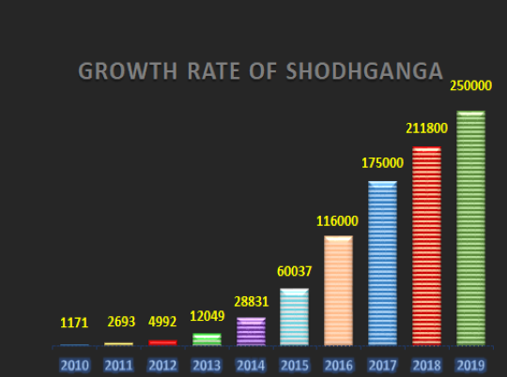
CB:- Publication
Two days online International training on research manuscript drafting and publishing
Finally---Let start easy journey then…
SHODHGANGA (https://shodhganga.inflibnet.ac.in/)
Platform for PhD Thesis.
For Indian Thesis.
@270029 full test thesis,
440 university contributing,..

Slide 37

CB:- Publication
Two days online International training on research manuscript drafting and publishing
Measure….
BOOK
JOURNAL

Slide 38
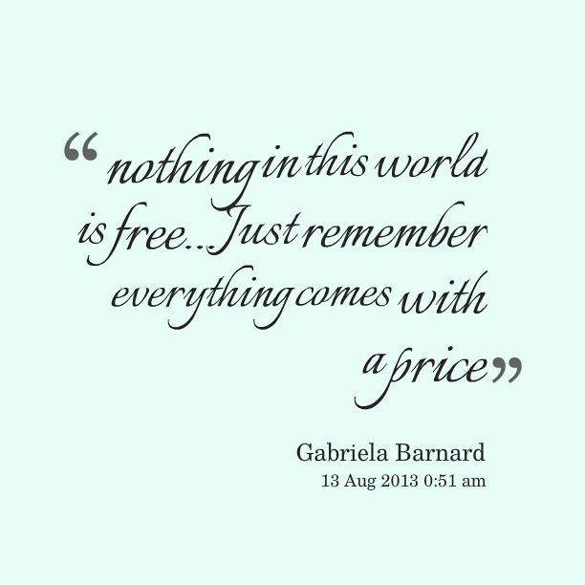
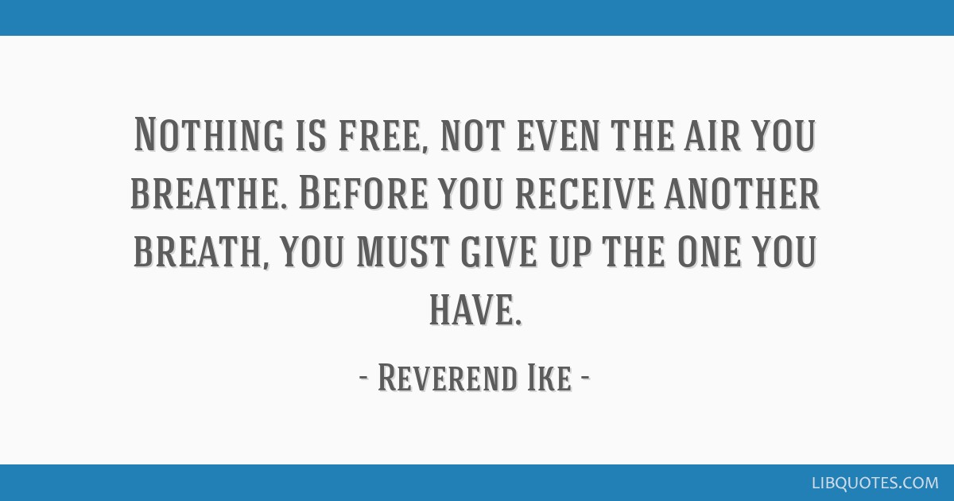
Always worth….
Two days online International training on research manuscript drafting and publishing
Always worth….

Slide 39
CB:- Publication
Two days online International training on research manuscript drafting and publishing
References (Some of those…)
https://selfpublishing.com/self-publishing-companies/
Photos: Google
Popularize your research, By Aïna Olagnon
https://en.wikipedia.org/
Avoiding Thesis and Dissertation Pitfalls: 61 Cases of Problems and Solutions, By Robert Murray Thomas, Dale L. Brubaker
Managing Intellectual Property in the Book publishing Industry A business-oriented information booklet, WIPO.

Slide 40
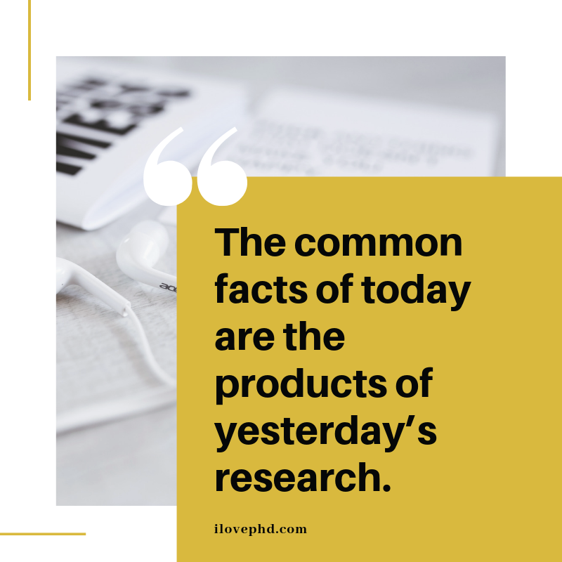
Maybe yours too…
Two days online International training on research manuscript drafting and publishing

Slide 41
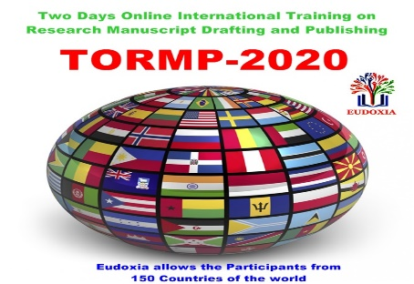

Two days online International training on research manuscript drafting and publishing
Thank You
Contact: b.hemlal@gmail.com

